Slide 1

Learning Objective
I will find the Five Number Summary
Enter quietly, please be ready with the following on your desk:
Whiteboard
Whiteboard marker
Exercise Book
Pencil, pen, ruler and red pen
Diary
Calculator
Device – charged or borrowed from Library before maths

Slide 2
Learning Objective
CFU 1
What will we learn?
I will find the median, the upper quartile and the lower quartile of a set of numbers (a data set).
CFU 2
What will we learn?
CFU 3
How will we know if we’ve been successful?
Success Criteria
CFU 4
How will we know if we’ve been successful?
I will be able to:
Find the median of a data set with an odd or even amount of numbers.
Find the upper or lower quartile of a data set with an odd or even amount of numbers.

Slide 3
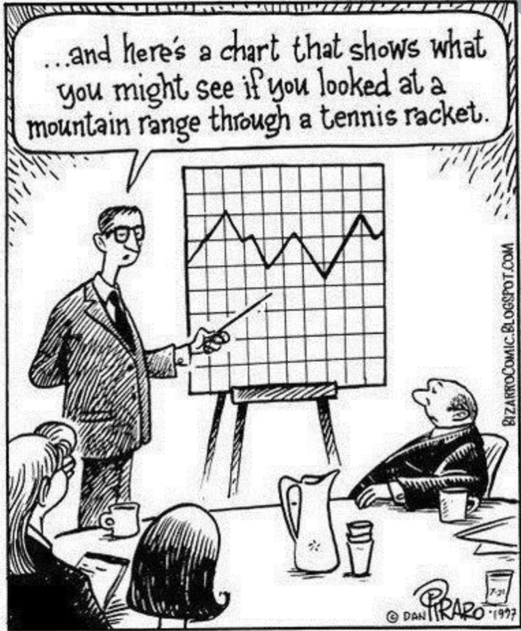
Activate Prior Knowledge
We see statistics being used all the time, but in order to draw conclusions or make decisions, we need to understand how to organise and analyse this data.
Statistics are used by all sorts of organisations to make decisions and convince others of what to do.
Understanding the processes used to collect, analyse and present data will help you to tell the difference between credible facts and unlikely fiction!

Slide 4
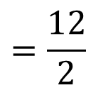
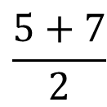
Daily Review
Measures of Centre
Median – The median is the middle value of an ordered data set.
To find the Median
Step 1: Order the numbers from smallest to largest
Step 2: Find the middle number*
*If the middle is between two numbers, then add them up and divide by two.
For this data set:
Order from smallest to largest.
Median =
$$\frac{5+7}{2}$$
9, 3, 9, 7, 5, 4
3, 4, 5, 7, 9, 9
$$=\frac{12}{2}$$
Find the middle.
= 6

Slide 5
Daily Review
Measures of Centre
Median – The median is the middle value of an ordered data set.
Find the median of the following data sets.
7, 9, 2, 4, 2
12, 11, 19, 10
11, 12, 11, 13, 17, 13, 12, 15
2, 2, 4, 7, 9
10, 11, 12, 19
11, 11, 12, 12, 13, 13, 15, 17
Median = 4
Median = 11.5
Median = 12.5

Slide 6
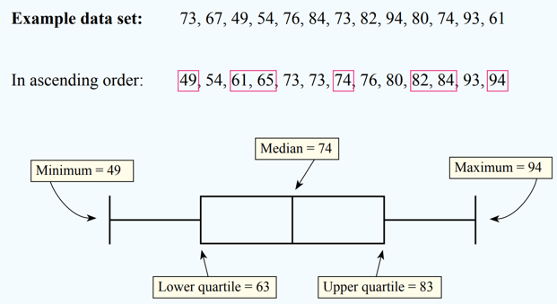
Concept Development
CFU 1
What information do we need to draw a box plot?
Over the next few lessons, we are going to learn how to create, draw
and compare box plots (box and whisker plots).
The box plot is a quick way of examining and comparing sets of data graphically.
The box plot is based on five pieces of information from a data set:
The minimum
The lower quartile
The median
The upper quartile
The maximum.
VOCABULARY
Box plot Quartile

Slide 7


Skill Development
CFU 1
How do you find the median if there’s two middle numbers?
To find the median of a data set:
Step 1: Order the numbers from smallest to largest
Step 2: Find the middle number*
*If the middle is between two numbers, then add them up and divide by two.
Find the median of the following sets of scores:
2, 7, 5, 1, 3, 5, 7
1, 2, 3, 5, 5, 7, 7
Median = 5
2, 7, 5, 1, 3, 5, 7, 4
1, 2, 3, 4, 5, 5, 7, 7
Median = $\frac{4+5}{2}$
= 4.5
On your whiteboards:
1, 3, 5, 2, 7, 7, 500, 8
1, 2, 3, 5, 7, 7, 8, 500
Median = $\frac{5+7}{2}$
= 6

Slide 8


Skill Development
CFU 1
How do you find the lower quartile if there’s two middle numbers?
The lower quartile is the median of the lower half of the data set.
Step 1: Underline the lower half of the data set.
Step 2: Find the middle number*
*If the middle is between two numbers, then add them up and divide by two.
If the median is one of the values, don’t include it in the lower half.
If the median is between two values, include it in the lower half.
Find the lower quartile of the following sets of scores:
2, 7, 5, 1, 3, 5, 7
1, 2, 3, 5, 5, 7, 7
Median = 5
Lower quartile = 2
2, 7, 5, 1, 3, 5, 7, 4
1, 2, 3, 4, 5, 5, 7, 7
Median = $4.5$
Lower quartile = 2.5
On your whiteboards:
1, 3, 5, 2, 7, 7, 500, 8
1, 2, 3, 5, 7, 7, 8, 500
Median = $6$
Lower quartile = 2.5

Slide 9
Skill Development
CFU 1
How do you find the upper quartile if there’s two middle numbers?
The upper quartile is the median of the upper half of the data set.
Step 1: Underline the upper half of the data set.
Step 2: Find the middle number*
*If the middle is between two numbers, then add them up and divide by two.
If the median is one of the values, don’t include it in the upper half.
If the median is between two values, include it in the upper half.
Find the upper quartile of the following sets of scores:
2, 7, 5, 1, 3, 5, 7
1, 2, 3, 5, 5, 7, 7
Median = 5
Lower quartile = 2
Upper quartile = 7
2, 7, 5, 1, 3, 5, 7, 4
1, 2, 3, 4, 5, 5, 7, 7
Median = 4.5
Lower quartile = 2.5
Upper quartile = 6
On your whiteboards:
1, 3, 5, 2, 7, 7, 500, 8
1, 2, 3, 5, 7, 7, 8, 500
Median = 6
Lower quartile = 2.5
Upper quartile = 7.5

Slide 10
Guided Practice
To find the median of a data set:
Step 1: Order the numbers from smallest to largest. Step 2: Find the middle number.
Find the median, lower quartile and upper quartile of the following data set:
13, 15, 13, 11, 16, 13, 12, 15
11, 12, 13, 13, 13, 15, 15, 16
To find the lower quartile of a data set:
Step 1: Underline the bottom half of the data set. Step 2: Find the middle number.
To find the upper quartile of a data set:
Step 1: Underline the top half of the data set. Step 2: Find the middle number.
Median = 13
If the median is one of the values, don’t include it in the lower/upper half.
If the median is between two values, include it in the lower/upper half.
Lower quartile = 12.5
Upper quartile = 15

Slide 11
Guided Practice
To find the median of a data set:
Step 1: Order the numbers from smallest to largest. Step 2: Find the middle number.
Find the minimum, maximum, median, lower quartile and upper quartile of the following data set:
2, 9, 4, 2, 5, 8, 9, 6, 6, 2, 3, 7, 5
2, 2, 2, 3, 4, 5, 5, 6, 6, 7, 8, 9, 9
To find the lower quartile of a data set:
Step 1: Underline the bottom half of the data set. Step 2: Find the middle number.
To find the upper quartile of a data set:
Step 1: Underline the top half of the data set. Step 2: Find the middle number.
Minimum = 2
If the median is one of the values, don’t include it in the lower/upper half.
If the median is between two values, include it in the lower/upper half.
Maximum = 9
Median = 5
Lower quartile = 2.5
Upper quartile = 7.5

Slide 12
Guided Practice
To find the median of a data set:
Step 1: Order the numbers from smallest to largest. Step 2: Find the middle number.
Find the median, lower quartile and upper quartile of the following data set:
435, 275, 195, 460, 565, 650, 335
195, 275, 335, 435, 460, 565, 650
To find the lower quartile of a data set:
Step 1: Underline the bottom half of the data set. Step 2: Find the middle number.
To find the upper quartile of a data set:
Step 1: Underline the top half of the data set. Step 2: Find the middle number.
Median = 435
If the median is one of the values, don’t include it in the lower/upper half.
If the median is between two values, include it in the lower/upper half.
Lower quartile = 275
Upper quartile = 565

Slide 13
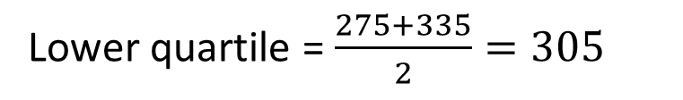

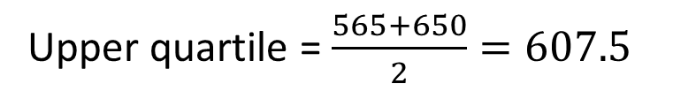
Guided Practice
To find the median of a data set:
Step 1: Order the numbers from smallest to largest. Step 2: Find the middle number.
Find the minimum, maximum, median, lower quartile and upper quartile of the following data set:
435, 275, 195, 460, 565, 650, 335, 800
195, 275, 335, 435, 460, 565, 650, 800
To find the lower quartile of a data set:
Step 1: Underline the bottom half of the data set. Step 2: Find the middle number.
To find the upper quartile of a data set:
Step 1: Underline the top half of the data set. Step 2: Find the middle number.
Minimum = 195
If the median is one of the values, don’t include it in the lower/upper half.
If the median is between two values, include it in the lower/upper half.
Maximum = 800
Median = $\frac{435+460}{2}=447.5$
Lower quartile = $\frac{275+335}{2}=305$
Upper quartile = $\frac{565+650}{2}=607.5$

Slide 14
Skill Development
To find the median of a data set:
Step 1: Order the numbers from smallest to largest. Step 2: Find the middle number.
By finding the 5 number summary of the data set, calculate the range and the inter-quartile range.
36, 52, 53, 55, 61, 66, 78
Minimum = 36
Lower quartile (Q1) = 52
Median = 55
Upper quartile (Q3) = 66
Maximum = 78
To find the lower quartile of a data set:
Step 1: Underline the bottom half of the data set. Step 2: Find the middle number.
To find the upper quartile of a data set:
Step 1: Underline the top half of the data set. Step 2: Find the middle number.
If the median is one of the values, don’t include it in the lower/upper half.
If the median is between two values, include it in the lower/upper half.
Range (maximum – minimum):
78 – 36 = 42
Inter-quartile range (Q3 – Q1):
66 – 52 = 14

Slide 15
Guided Practice
To find the median of a data set:
Step 1: Order the numbers from smallest to largest. Step 2: Find the middle number.
By finding the 5 number summary of the data set, calculate the range and the inter-quartile range.
21, 34, 53, 65, 66, 67, 92
Minimum = 21
Lower quartile (Q1) = 34
Median = 65
Upper quartile (Q3) = 67
Maximum = 92
To find the lower quartile of a data set:
Step 1: Underline the bottom half of the data set. Step 2: Find the middle number.
To find the upper quartile of a data set:
Step 1: Underline the top half of the data set. Step 2: Find the middle number.
If the median is one of the values, don’t include it in the lower/upper half.
If the median is between two values, include it in the lower/upper half.
Range (maximum – minimum):
92 – 21 = 71
Inter-quartile range (Q3 – Q1):
67 – 34 = 33

Slide 16
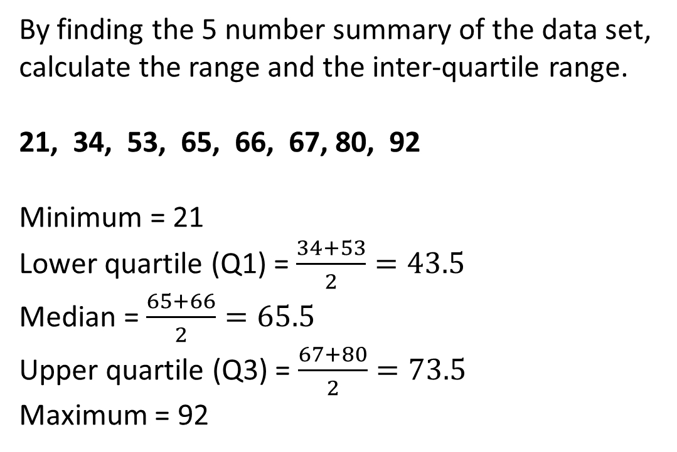
Guided Practice
To find the median of a data set:
Step 1: Order the numbers from smallest to largest. Step 2: Find the middle number.
By finding the 5 number summary of the data set, calculate the range and the inter-quartile range.
21, 34, 53, 65, 66, 67, 80, 92
Minimum = 21
Lower quartile (Q1) = $\frac{34+53}{2}=43.5$
Median = $\frac{65+66}{2}=65.5$
Upper quartile (Q3) = $\frac{67+80}{2}=73.5$
Maximum = 92
To find the lower quartile of a data set:
Step 1: Underline the bottom half of the data set. Step 2: Find the middle number.
To find the upper quartile of a data set:
Step 1: Underline the top half of the data set. Step 2: Find the middle number.
If the median is one of the values, don’t include it in the lower/upper half.
If the median is between two values, include it in the lower/upper half.
Range (maximum – minimum):
92 – 21 = 71
Inter-quartile range (Q3 – Q1):
73.5 – 43.5 = 30

Slide 17
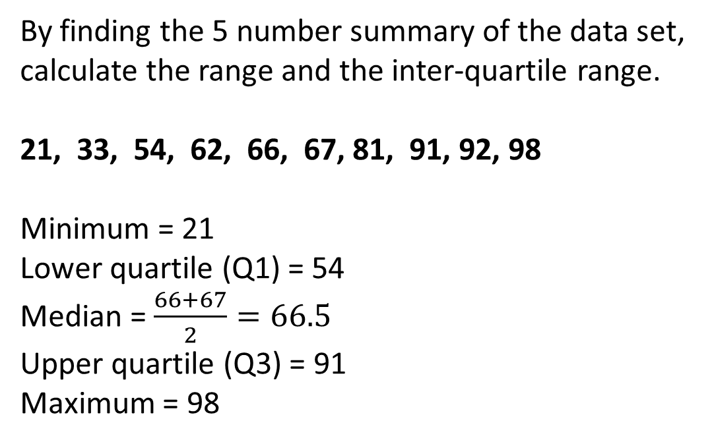
Guided Practice
To find the median of a data set:
Step 1: Order the numbers from smallest to largest. Step 2: Find the middle number.
By finding the 5 number summary of the data set, calculate the range and the inter-quartile range.
21, 33, 54, 62, 66, 67, 81, 91, 92, 98
Minimum = 21
Lower quartile (Q1) = 54
Median = $\frac{66+67}{2}=66.5$
Upper quartile (Q3) = 91
Maximum = 98
To find the lower quartile of a data set:
Step 1: Underline the bottom half of the data set. Step 2: Find the middle number.
To find the upper quartile of a data set:
Step 1: Underline the top half of the data set. Step 2: Find the middle number.
If the median is one of the values, don’t include it in the lower/upper half.
If the median is between two values, include it in the lower/upper half.
Range (maximum – minimum):
92 – 21 = 71
Inter-quartile range (Q3 – Q1):
73.5 – 43.5 = 30

Slide 18
Independent Practice
Mathspace – Year 10 Mainstream Five Number Summary CLASSWORK

